Slide 1
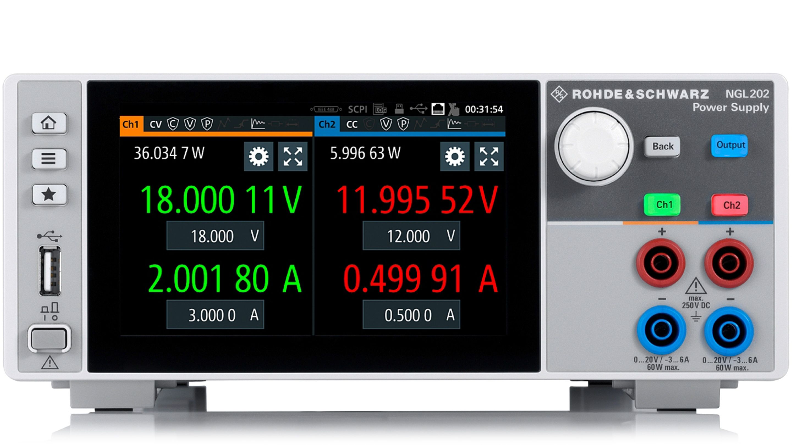
Knob
Home
Output
Menu
Channel select
USB port
Output ports
Power

